Slide 1
Priyadarshini Polysacks Ltd.
Pioneers in manufacture of Polypropylene Woven Sacks
Office : F-41,1st Floor, Trade Centre, Station Road, Kolhapur - 416001,
Maharashtra, India. Ph. No. (0231) 2667342 /44/47/49.
Fax No. (0091-0231) – 2652241.
Factory : Plot No. 20/2, M.I.D.C, Shiroli -416122, Maharashtra India.
Email ; priyadarshini_polysacks@yahoo.com, priyaoffice@yahoo.com.
Web Site : www.priyabags.com.

Slide 2
About Us
Priyadarshini Polysacks Ltd has attained recognition among India’s Top 5 Woven Sacks
Manufacturers in terms of volume, manufacturing as well as processing capacity. Owing to our
substantial capacity in fabricating 10 million Sugar Bags per annum, we have attained the position
among the largest Sugar Bag Manufacturers based in India. Highly useful for its water proofing
applications, our PP Cement Bags, PP Leno Mesh Bags, PP Bags, BOPP Bags, LLDPE Liners and
PP Yarn help in preventing moisture from entering the materials. We have continuously expanded
since the past few decades due to our sheer sincerity, dedication, proactive approach and innovative
techniques leading to supreme quality and service to our customers.

Slide 3
Quality Assurance Since the inception of the organization in 1985, all our endeavours are placed in providing superior quality range of PP Bags to our clients. For this we have installed a number of testing machines like: 1.Tape Strength Testing Machines 2.Fabric Strength Testing Machines 3.Denier Testing Machines 4.Miscellaneous (Micrometre, TGauge etc.)
5. Six Sigma, Japanese- Kaizen System
We have recently been accredited with DGSN & D Certification from Mumbai which will prove useful in bagging the F.C.I. (Food Corporation of India) order Contract Validity in the long run.

Slide 4
Manufacturing Unit
Located in the city of Kolhapur, (Maharashtra), we maintain top class manufacturing facilities across all departments like Tape making, Fabric Making and finally Bag making i.e. finishing. We are empowered with advance machineries and equipment's which are indispensable part of our production process and include :
1.Tape Plants. 6.Stitching M/c’s. 11.Bailing M/c’s.
2.Winders. 7.Lamination Plants. 12.Chilling Plant.
3.Quality Testing Equipment’s 8.Liner Plants. 13.Cooling Towers.
4.Weaving Looms. 9.PP Fibrillated Yarn making M/c. 14. Vavlomatic M/c’s.
5. Printing M/c’s 10.BCS M/c. 15. Spin Draw Windline (lofil) M/c’s

Slide 5
COMPANY - PROFILE
A) GENERAL INFORMATION
Name of the Organization : PRIYADARSHINI POLYSACKS LTD.
Registered office/Postal Address : F-41,1st Floor, Trade Centre, Station Road,
Kolhapur – 416 001. Maharashtra State, India.
Telephone Number : (0091-0231) – 2667342 / 44 / 47 / 49
Direct No. of MD : (0091-0231) – 2667341
Direct No. of Jt. MD : (0091-0231) – 2667339
Direct No. of D.O. : (0091- 0231) - 2667340
Fax Number : : (0091-0231) - 2652241
Website Address : www.priyabags.com
Email I.D. : priyadarshini_polysacks@yahoo.com / priyaoffice@yahoo.com

Slide 6
Factory / Work’s address – UNIT-I : Plot No. : 20/2, M.I.D.C. Shiroli, Kolhapur – 416 122.
E-mail: priyaworks@yahoo.com
Factory / Work’s address – UNIT-II : Plot No. : 15, M.I.D.C. Shiroli, Kolhapur – 416 122.
E-mail : priyaworks_unit2@yahoo.in
Telephone Number : 0091-0230) - 2468327 / 2468927 / 2460641.
Fax Number : (0091-0230) - 2460642.
Key Person for Contact : 1) Mr. N.C.Sanghvi (M. D.)-098220-49542 (nemchand_sanghvi@rediffmail.com)
2) Mr. S.N.Sanghvi (Jt. MD)-098901-65542 (sanghvi.sn@gmail.com /shitalns@priyabags.com )
3) Mr. P. N. Sanghvi (D.O.)–MS-USA) - 09881465669 (pritamsanghvi1979@gmail.com/pritamns@priyabags.com)
Status of the firm : Limited Company
Area of Activity : Manufacturing of Circular Woven Sacks. (i.e. Conversion of Granules into Printed Sacks)

Slide 7
Year of Establishment / Commencement : 1986 / 1987
Registration details / No. & Date : We have registered with MINISTRY OF INDUSTRIES AND DEPARTMENT OF INDUSTRIAL DEVELOPMENT Under their Letter No. 276/SIA/IMO/93.Dt.4.8.93.
Factory Act. : YES – Registered.
Companies Act. : YES – Registered.
S.S.I. Unit : NO.
Pollution Certificate : Yes, Consent No. MPCB/IRO/KOP/759/11/ Dtd. 30.11.11
B) FINANCIAL & TAX INFORMATION
Annual Turnover of last 3 Financial Year : 200 Crs.
CIN No. : U25209MH1985PLC036373

Slide 8
Banker’s Name & Address : 1) Axis Bank,
2) Bank of Baroda,
3) HDFC Bank,
Income Tax Registration No. & Date : AABCP 5804 F
Central Sales Tax Registration No. & dt. : 416122 C – 13 / 1-4-96.
State Sales Tax Registration No. & dt. : 416122 S – 14 / 1-4-96.
Duty & Taxes (As applicable) : Excise Duty - 12.36 % , CST- 2% and VAT 5%
ECC No. : AABCF5804FXM002
TIN No : 27080410020V, 27080410020C
GST No. : 27AABCP5804F1ZM

Slide 9
C) MAN – POWER & PRODUCTION INFORMATION: -
Work – Force : 250 No's (on muster) + Contractual Team as per Needs.
Management Executive’s : 1) N.C. Sanghvi - Chairman & MD. 2) S.N. Sanghvi – Jt.MD. 3) P.N. Sanghvi – D. O. [MS, ISE-USA), SAP-Certified.
Company Team : Mr. D. Singh – (VP)
Mr. Mishra – (Production Manager (U2))
Mr. Patel – (Production Incharge (U1)
Mr. Londhe ( Mngr. Finishing ) Mr. Shaha, (Mrktg. Mngr.) Mr. Hasmukh Jain ( Mumbai) – Liasioning Mng.

Slide 10
Mr. Sairam (Mngr.Mktg., Chennai ) Mr. Dabholkar (Manager Accounts)
Mr. Kadgond – (Manager Finance) Mr. Tiwari –(Mngr. Mrktg. – Delhi)
Qualified Engineer’s & Supervisors : 30 Nos.
Production Capacity : 6.5 Lac bags per day. ( 1700 MT /Month )
For Cement, Chemical, Export, Liners , Leno, Fertilizer’s, Sugar, Food-Grains, Textiles , Fabrics, etc.

Slide 11
D) MACHINERY INFORMATION
Tape – Plant Section
No. of Extruders : 6 Nos.
Make of Extruders 1) Lohia Starlinger (90mm) 4.8 MT (Leno)
2) Lohia 120 mm 12 MT (Cement)
3) J.P. Industries (80 mm) 3 MT (Leno)
4) Lohia (120 mm) 5.5 MT (Leno)
5) J.P. Industries. (90 mm) 7.5 MT
6) J.P. Industries (80 mm) 6 MT
------------ TOTAL → 38.8 MT / day
Our Tapeline has been fitted with Auto screen charger for best quality Tape Line.
Production Capacity (Installed) : 1000 MT/Month

Slide 12
Fabric – Loom Section
No. of Looms : 248 Nos.
Make of Looms
Process of Looms (Circular / Flat) : Circular.
Liner Cutting Sealing Machine : 3 No. ( XL Plastic Make) Prod.-1.5 Lac liner/day.
Lamination (Extrusion -Coating M/c.) : 1 Nos. 5 MT per day (JP Ind. Make – 2 meter width coating. 1-lac mts/day prod. Capacity
Bibilofil M/c. : Lohia Make 80 Kgs /Hr. M.F.Yarn Mfg.
Valvomatic M/c. : Lohia Make – 7 Nos.
Stitching - Machine Section :
No. of Stitching Machine : 74 Nos.
Make of Stitching Machine : a. Stitchman Impex, Ahmedabad-Gabbar Make
Unit – I | Unit –II
CSN4 – 86 | NOVA -6- 16
 | LSL 6 – 33
 | Leno 4 – 123
 | GCL 6 - 19
86 | 191

Slide 13
Printing section :
No. of Printing Machine (Flexographic Manual type) : 2 No's ( 3 Color- 1 No,) & ( 2 Color – 1 Nos. )
Make of Printing Machine : Techno pack Industries, Bangalore.
Online Auto – Bag : Corona, Printing Cutting Machine. : 5 No's. (J.P.Industries - Ankleshwar) (4 Colour - 3 No's ) & (8 Colour – 1 No’s.) (6 Color - 1 No's )
Hydraulic – Bailing Machine (30 Tons & 60 Tons) : a. Navjivan Exports, Ahmedabad – 1 Nos.
(Compressed Bailing) b. Chimaho Automation System,
Belgaum - 4 Nos.
c. Hydro S&S, Bangalore – 2 No. d. Shrishti Engineers – 4 Nos. e. Supreme India Mach - 2 No.
Total - 12 No's

Slide 14
BCS (Bag Cut – Stitching M/c.) : 11 No.(Lohia, Armstrong,Blacksmith & Gabbar )
Liner Inserting (cirwrinding) : 1 No.
BTGM (Bag Twist Gusset M/c.) : 1 No. (Navrang Make)
Testing – Machine Section : a. Make of Fabric strength testing Machine : Kamal Metal Industries, Ahmedabad. – 2 Nos.
b. Make of Fabric strength testing Machine : Dutron Industries – 01 No.
c.Make of Tape strength testing Machine : Kamal Metal Industries, Ahmedabad. - 2 Nos. d. Make of Denier testing Machine : Kamal Metal Industries, Ahmedabad. – 2 Nos. e. Weighing Scale : Phonex Make, Citizen Makes, - 15 Nos. Seico India Make ( All M/c. converted in to Digital Technology in 2010)
e. Conditioning Chamber (Digital Type) : IKON Industries, Mumbai Make - (1 No.)
f. Muffle Furnace : 1 No.

Slide 15
Cooling – Towers : 8 No’s. ( Paharpur Make )
Chilling – Plant make : 1 No’s. Prasad - 15 TR , 4 No’s. Prasad - 30TR 1No’s Prasad – 40 TR.
A.P.F.C. (Automatic Power Factor Controller) : 4 No’s. (Siemens / GE Make)
Electrical Equipment's : G.E. / Siemens Make.
Gensets : 250 KVA – 1 No.( Greaves Make )
Factory - Flooring : TREMIX - Cementing Completely.
Shade Ventilators System : YES (250 No’s across both units at the roof – top)
(Sudha : Austria Make)
Air Compressor : 19 Nos. (ELGI, Chicago, Pneumatic, JR Make)

Slide 16
E) QUALITY INFORMATION
ISO – 9001 -2000 Certification : YES . NABCB, Certificate No.10F-0872, 13th Sept.’2010
ISO : 14001 – 2004 Certification : BN 5863/5229:0812 dtd. 27th Aug.12
ISO 18001 :2007 Certification : ALTIS Cert. ACS-OHSAS -1004, 13th July 2012
ISO – 22000:2005 Certification : ACS-FSMS-1009 dtd. 21st Sept.12
BIS Certificate : CM/N-7500055912 as per IS 16208:2015
D.G.S. & D Registration : DGS&D/REGN/MUM/L-10/2007/P Dtd. 2.11.2007
Rate Contract (DGS&D) : HDPE – PPBAG/HW-2/RC-R3060000/0611/42/04061/212 dated 1st Dec.’10
Do you have the Quality System : YES (We have implemented Japanese – KAIZEN system which includes : Total Quality System / Quality Production. Total Preventive Maintenance). Six –Sigma & SAP projects executed during 2006/07.

Slide 17
Do you have the Quality manual : YES.
Laboratory facilities (Major Instruments) Present : YES.
Quality – Lab (Air Conditioned) : YES
Testing facilities & Test conducted (As per BIS) : YES.
Safety - Audit (Electrical dept.) : YES (conducted in year 2008 at both the units- MITCON Consultant) Pune.
CRISIL /ICRA Rating : Our CRISIL /ECRA rating is done every year as per co. bank guidelines since 2008 onwards. Rating awarded is BBB – stable (B3). Latest is updated on Web page of CRISIL / ICRA

Slide 18
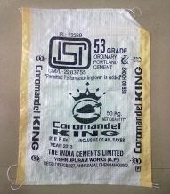
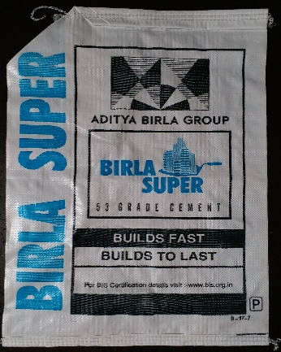
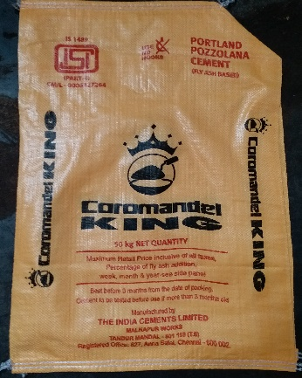
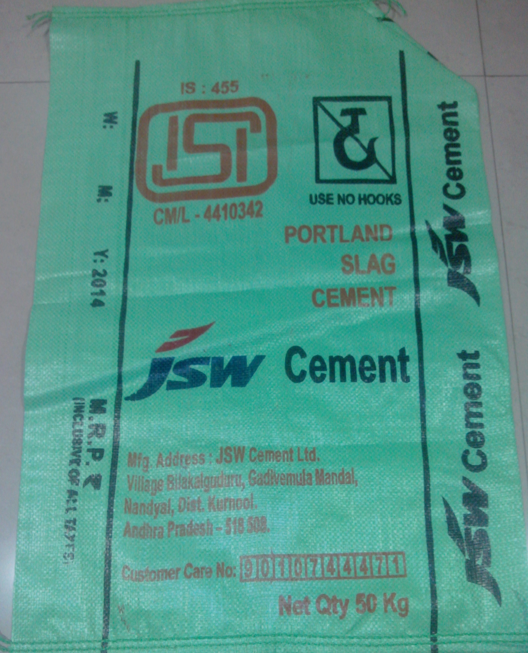
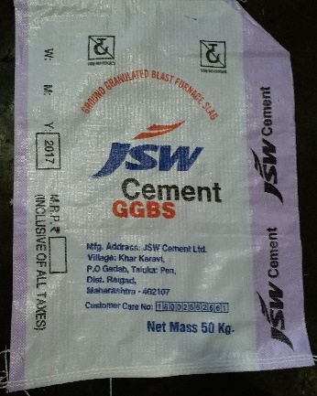
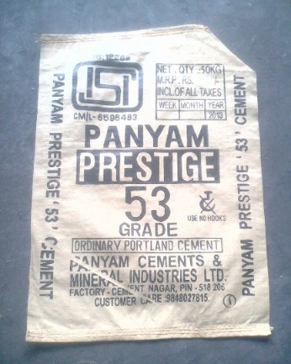
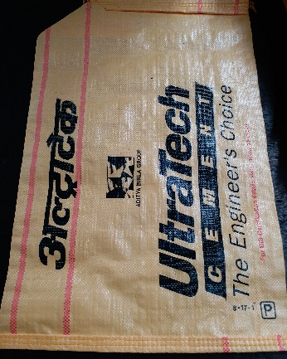
Cement Sector : 1 Cr. Bags/ Month
Jaypee Cement
The India Cements ( ICL Cement )
JK Cement
JK Cement
Birla Super Cement
ICL Cement
JSW Cement
JSW Cement
Zuari Cement
Panyam Cement
Ultratech Cement

Slide 19
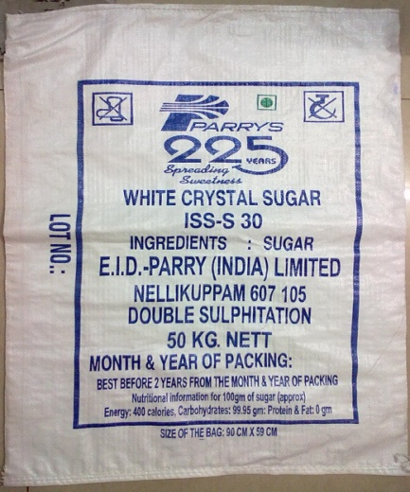
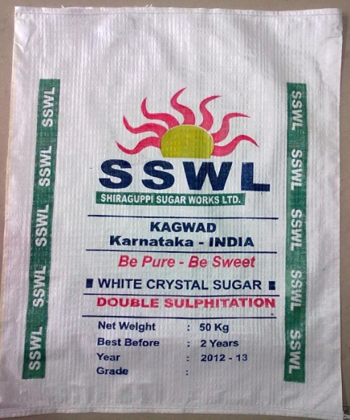
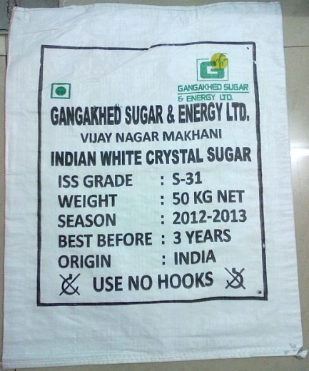
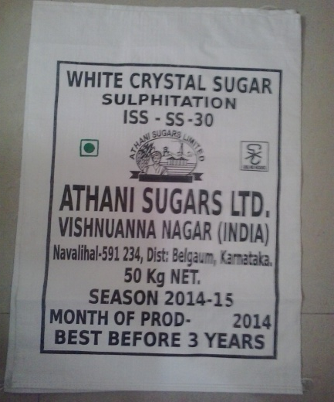
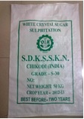
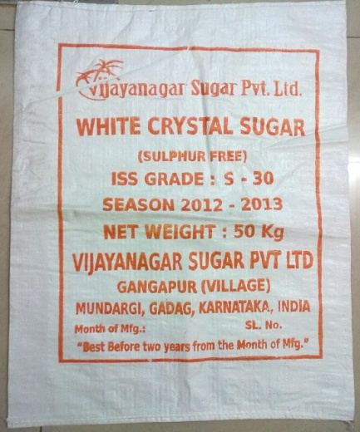
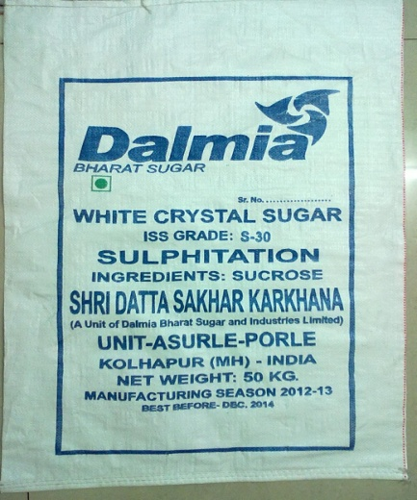
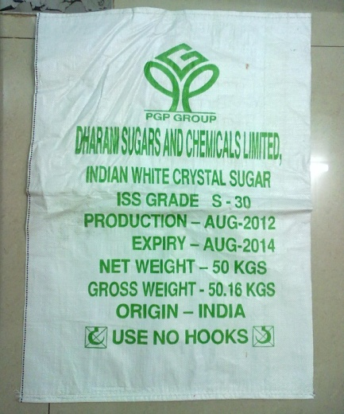
Sugar Sector : 40 Lac Bags per month
Reputed Karkhana’s across Country. :-
(In Maharashtra, Karnataka, Andhra Pradesh and Tamilnadu States)
EID Parry Sugar
Shiraguppi Sugar
Gangakhed Sugar
Athani Sugar
Dhoodganga
VijayNagar Sugar
Dalmia Sugar
Dharani Sugar

Slide 20
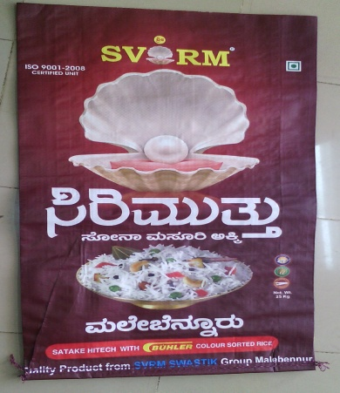
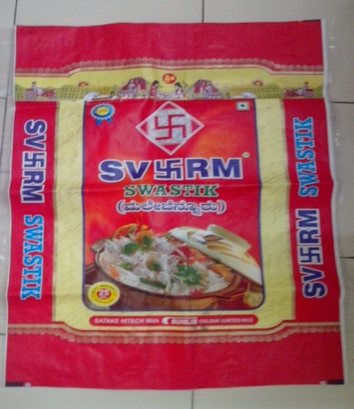
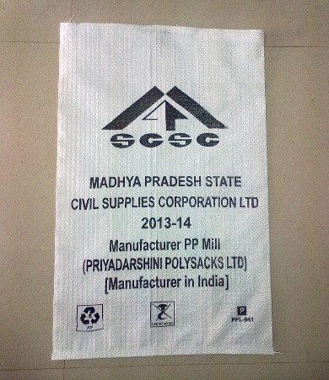
Leno , Food Grain & BOPP Sector
We manufacture leno bags of various sizes from 6” up to 28” (width) and cater to various States across India for packing of Agro products at
1.Maharastra State - Nasik, Lasalgaon, Mumbai, Pune, Sangamner 2.West – Bengal – Kolkata. 3.Uttar Pradesh – Kanpur. Monthly Capacity 4.Karnataka – Bijapur. 60 Lac Leno Bags. 5.Madhypradesh – Indore. 6.Andhra Pradesh – Hyderabad, 7.Punjab -Amritsar
BOPP Bag
SVRM BOPP Bag
SVRM BOPP Bag
Parmal BOPP Bag
FCI : DGS&D Food grain bags

Slide 21
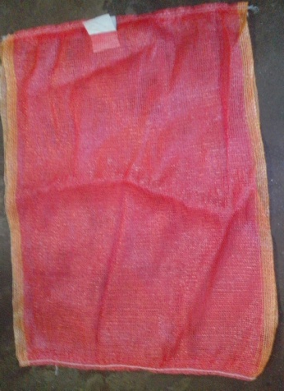
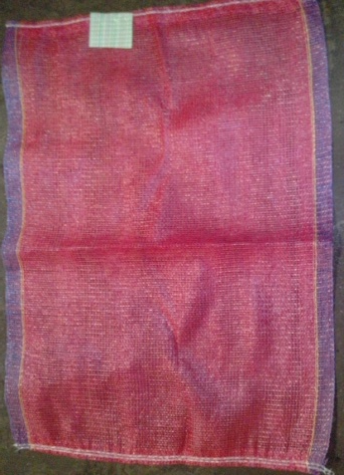
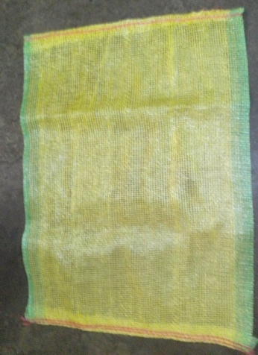
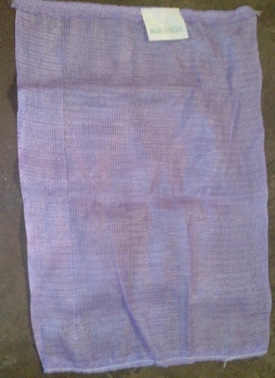
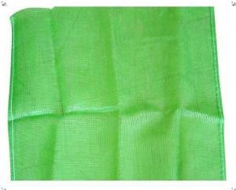
Various types of Leno Bags
Leno bags manufacture in various sizes i.e.
28x50, 32x48, 32x42, 28x42, 32x43, 24x40, 22x36, 22x38, 26x40, 28x45, 26x42, 30x45, 24x38, 22x40, 28x40, 24x42, 18x31, 32x42, 18x23, 20x34 Yellow, 16x35, 16x40, 18x23,
18x40, 22x30, 30x40 Yellow, 20x30 Yellow, 23x41, 22x36 Green, 22x34, 20x34, 2x26

Slide 22
Miscellaneous
Fertilizers
We have capacity to Laminate up to 25 lac PP/HDPE bags per month suitable for Fertilizer
Packing : - we do both inside as well as Outside Lamination. We also have set up to do BOPP
multicolor Bags.
Coromandal Fertilizers
Deepak Fertilizer, Discussion with other Cos.
Basant Agro Tech India Ltd., i.e. RCF, NFL, IFFCO, KRIBCO
BEC Fertilizers, Indian Potash is going –on.
Others Packing Applications
1) Starch
2) Star Group of Companies
3) Rice Packing (BOPP Bags)
4) Textile Packing
5) Spinning Yarn Packing
6) PP Laminated Bag for Packing of Polymer, Master batch, Compounds, Additions.
7) Only Liners
8) PP Fibrillated Yarn Production
9) Wrapping Low Denier,

Slide 32
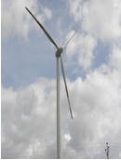
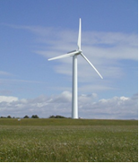
Wind – Mill Energy Division
We have done 2 Solar RE Power Renewable Energy - Windmill project of 6.1 MW by Suzlon & 4.5 MW of Regen Total 10.6 MW project in Maharashtra & have CDM Registration from UNFCCC, Germany for Carbon Credit benefits to be availed Globally. We are further adding our Wind Power Project @ 1.5 MW every year. In woven Sacks Sector ‘PPL’ is at highest rank Wind Energy in the Country. Company plans to convert the factory connected Power to Windmill captive type next year.
# 3.1 MW Solar power Captive Project, we install during 2016 -17 in PPL Unit II Co.
Suzlon (Geared MC) Regen (Gearless WTG)
(0.6 MW & 1.25 MW Size) (1.5 MW Size)
Suzlon (Geared MC)
Regen Power Tech (Gearless WTG)

Slide 33
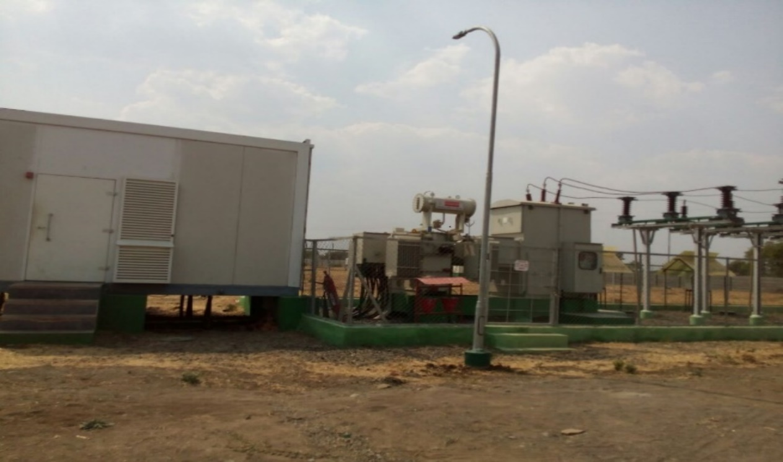
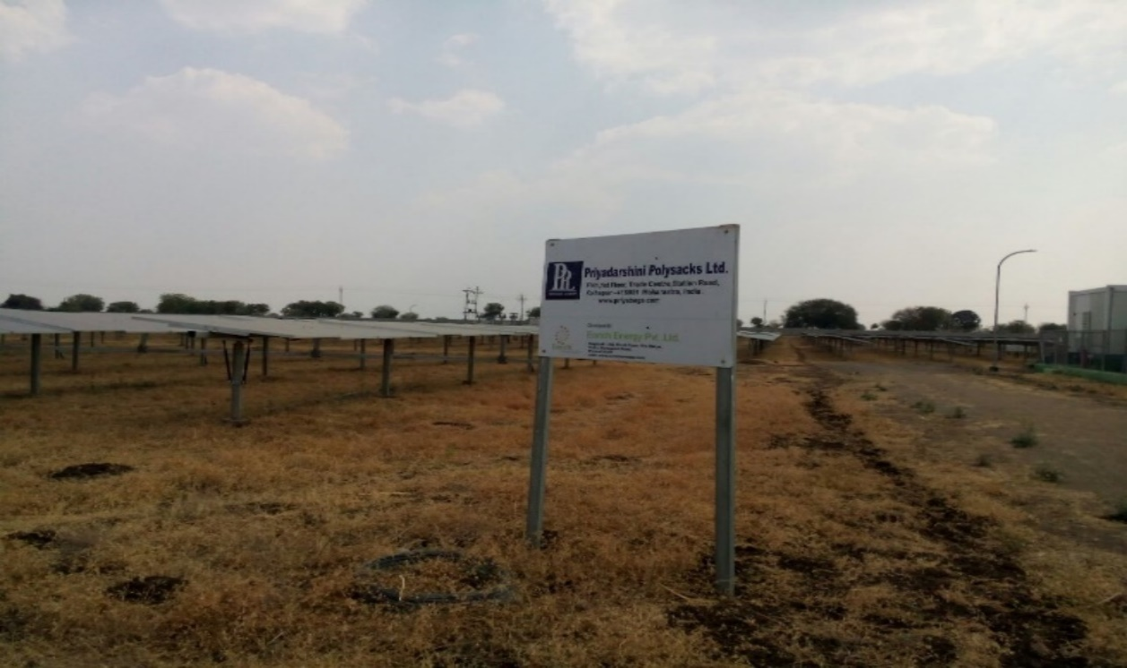
Solar Energy Division
Solar Plants at Karajagi, Solapur.
Capacity | LOC No. | Developer
1.1 M.W. | K12 | Enrich Energy Power Pvt. Ltd.
1.0 M.W. | K14
1.0 M.W. | K19

Slide 34
Process Flow Chart
RAW Material Consumption
PP Granules (+) mixing with MB, Filler Components
Granules Melting (In the extruder)
Melted material filtered from screen changer
PP Film from Die
Film cold process from quenching (water Tank)
Film slitting into Tape
Tape stitching in hot air oven
Tape Hot & cold process in chilled Roll (Annealing)
Tape-Winding (Bobbin –winders)
Bobbin checking & Cleaning
Fabric weaving in loom
Fabric Roll Cut, Checking & Stocking

Slide 35
Process Flow Chart
Printing (On auto Carona Machine
Printed fabric cutting in pieces
Cutted pieces checking & Sorting
Valve Forming
Valve Forming
Bag bottom stitching
Bag Quality Checking & Segregate (All quality parameter’s i.e. Size Weaving, Printing, Weight, strength, stitching) etc.
Counting
Bailing
Weightment
3rd party inspection ( ISOIL)
Finish Bag for Dispatch

Slide 36
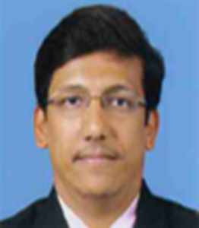
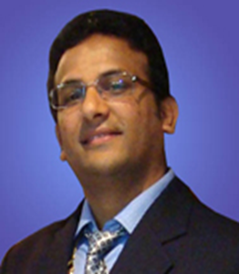
Directors Photos
Shri. Nemchand C. Sanghvi
Shri. Shital N. Sanghvi
Shri.Pritam N. Sanghvi
(Chaiman & MD)
(Joint. MD)
(Director Operations)

Slide 37
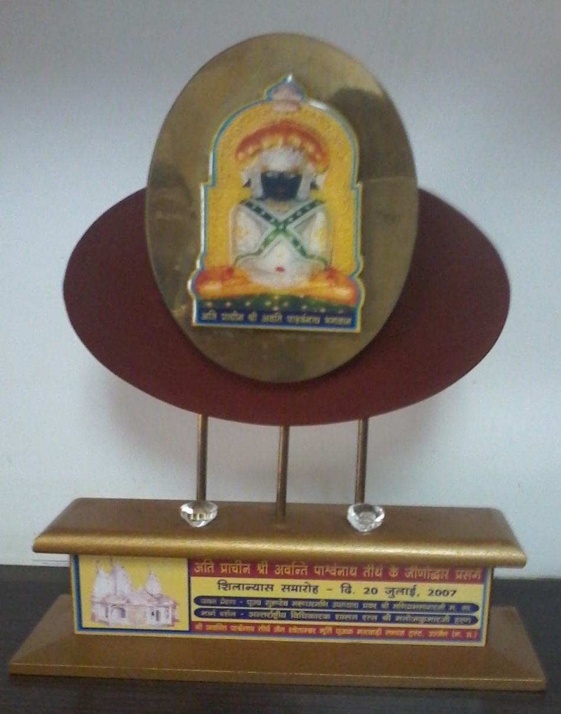
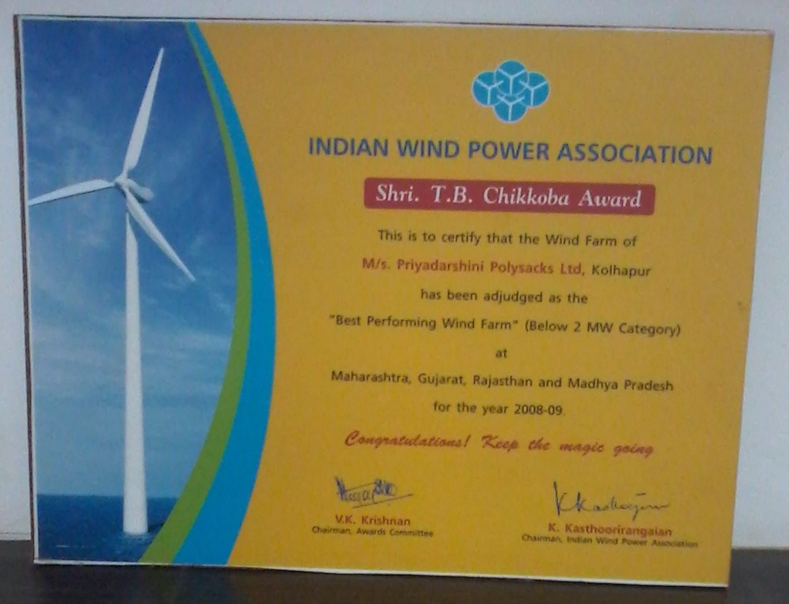
Achievements
Shilanyas Samaroh Award 20 July 2007
Shri T. B. Chikkoba Award
2008-2009

Slide 38
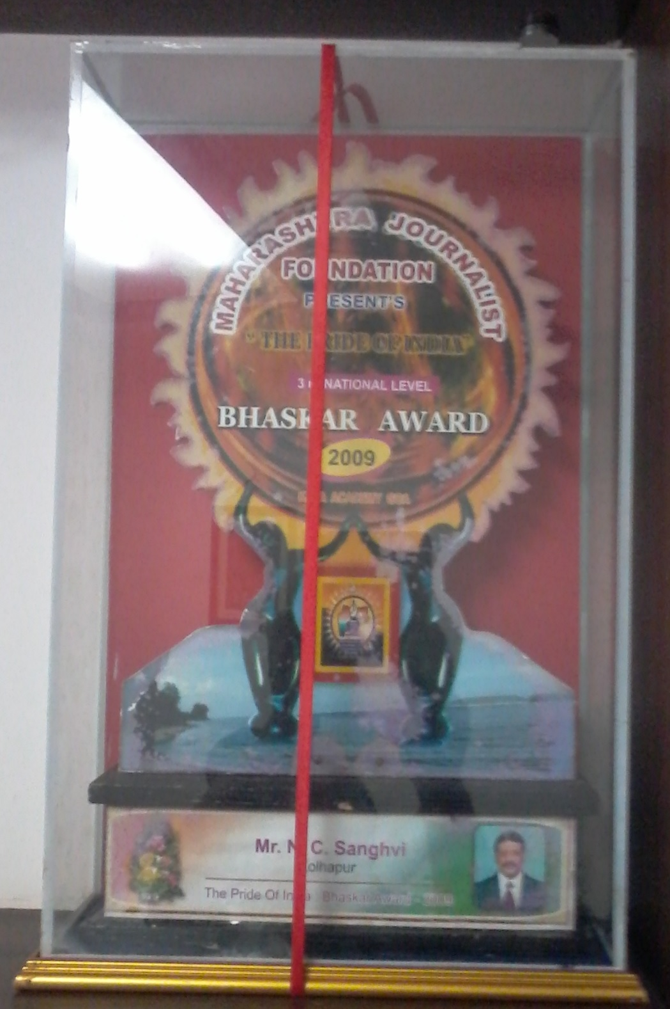
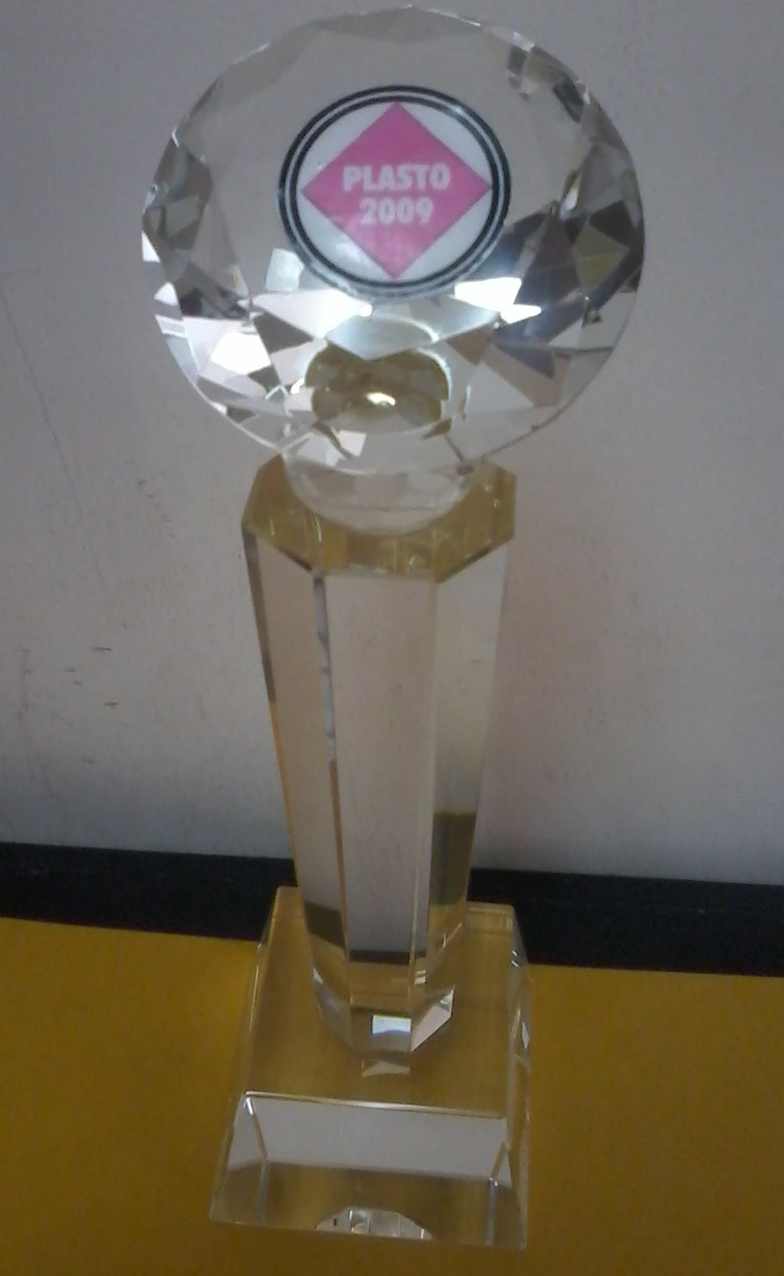
Bhaskar Award
2009
Plasto Award
2009

Slide 39
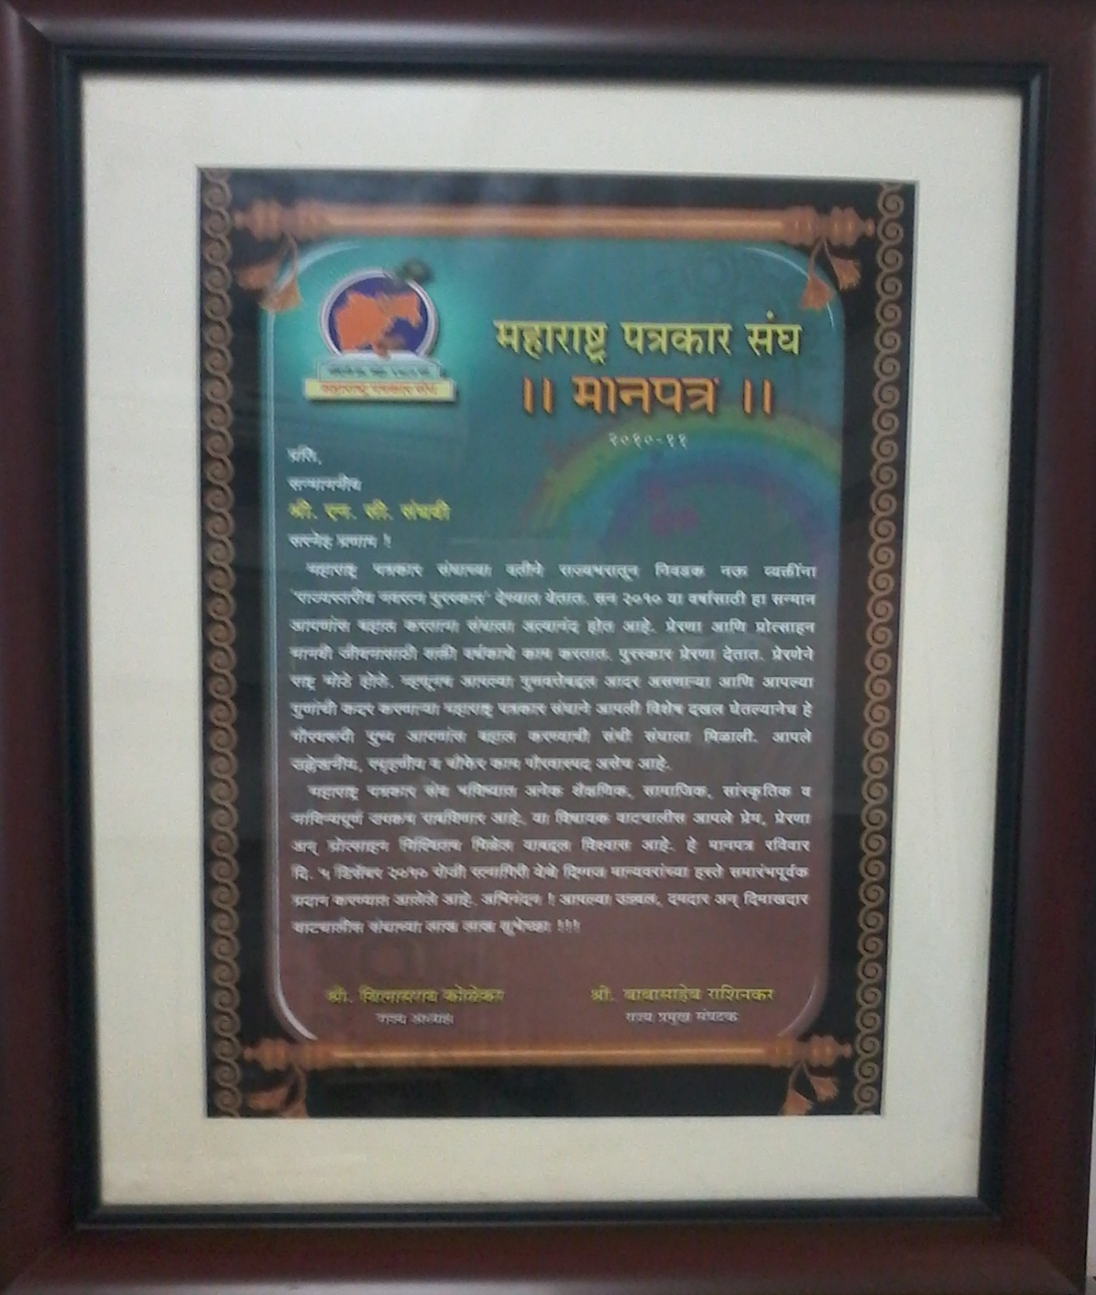
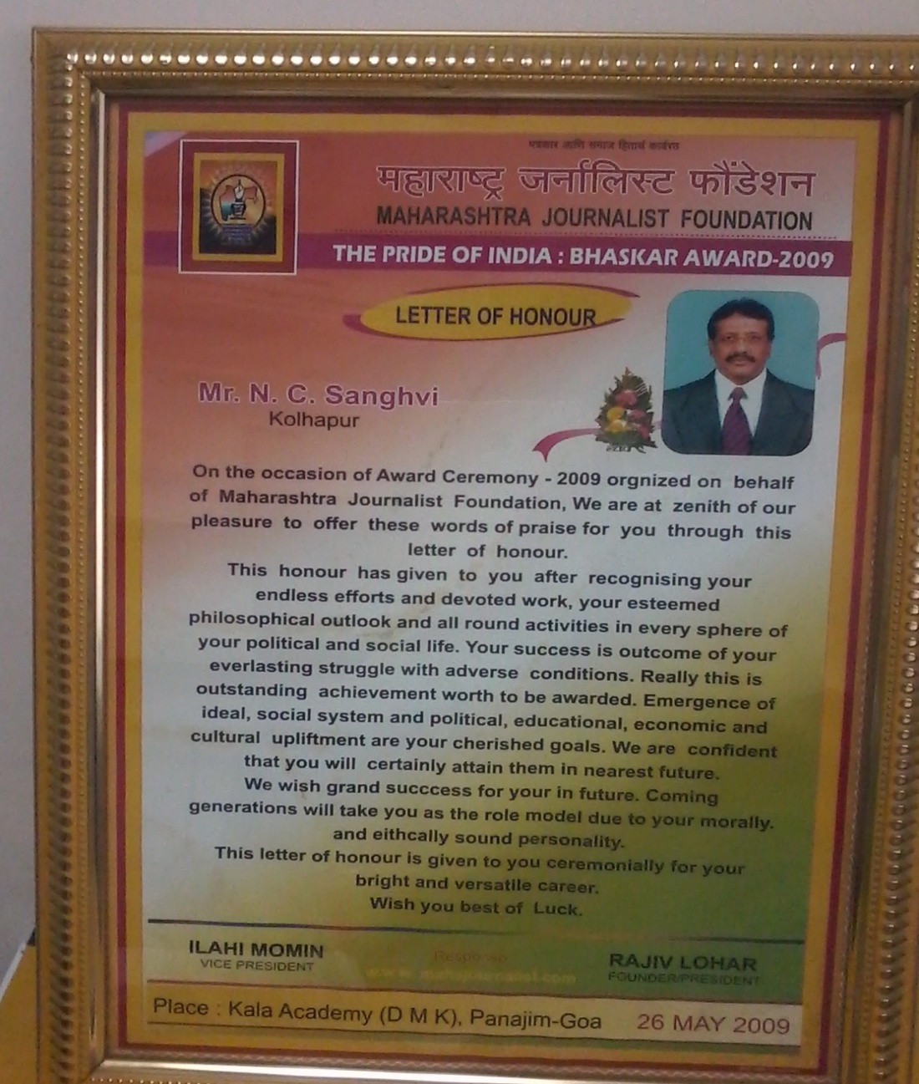
Maharashtra Patrakar Sangh Award
2009
Maharashtra Journalist Foundation Award
2009

Slide 40
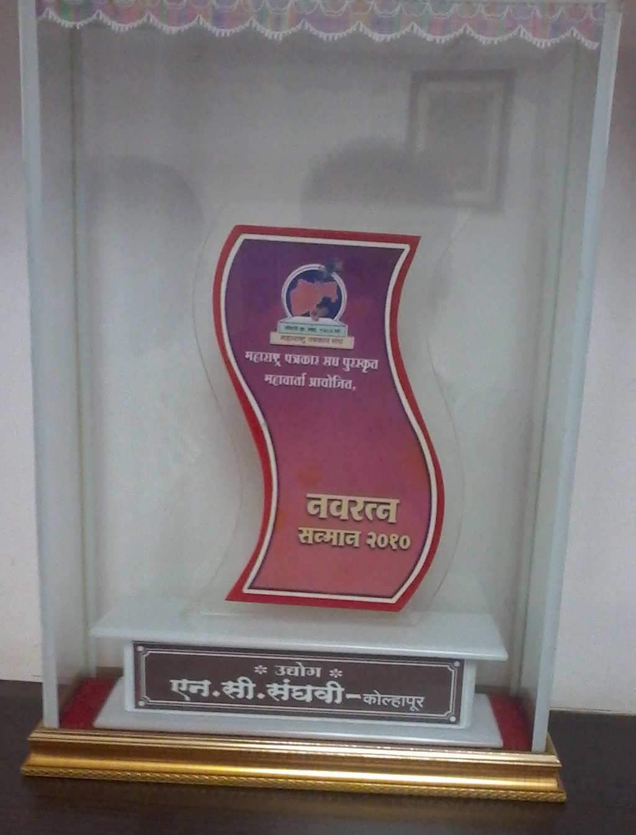
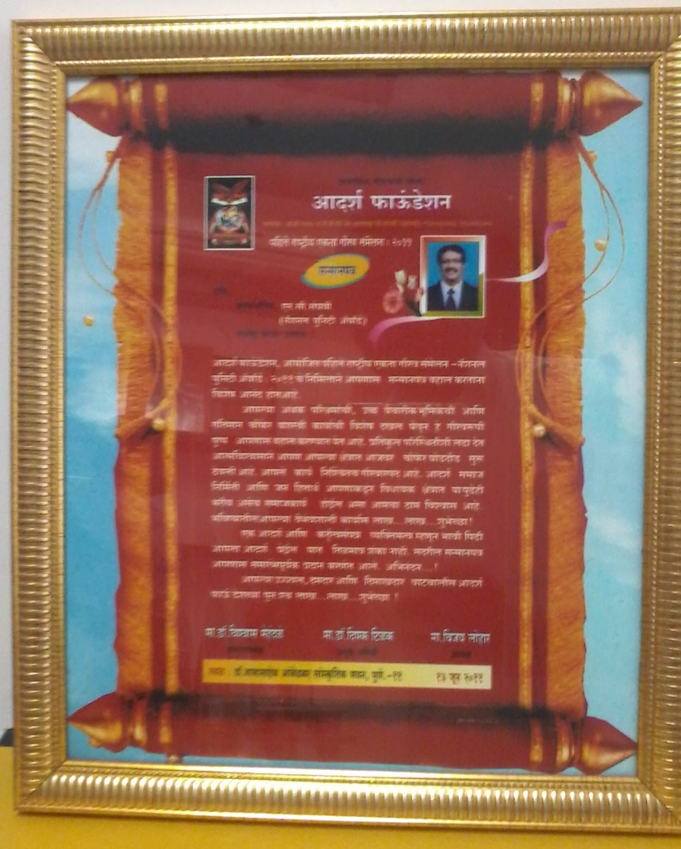
Navaratna Award
2010
Aadarsh Foundation Award
13 June 2011

Slide 41
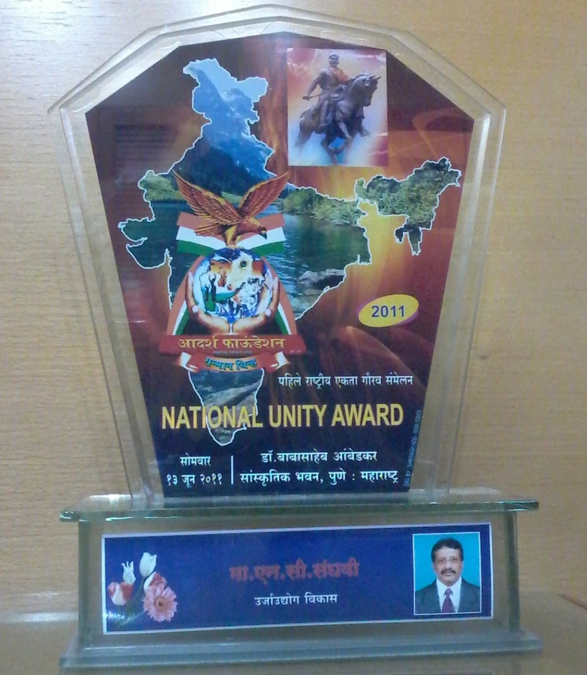
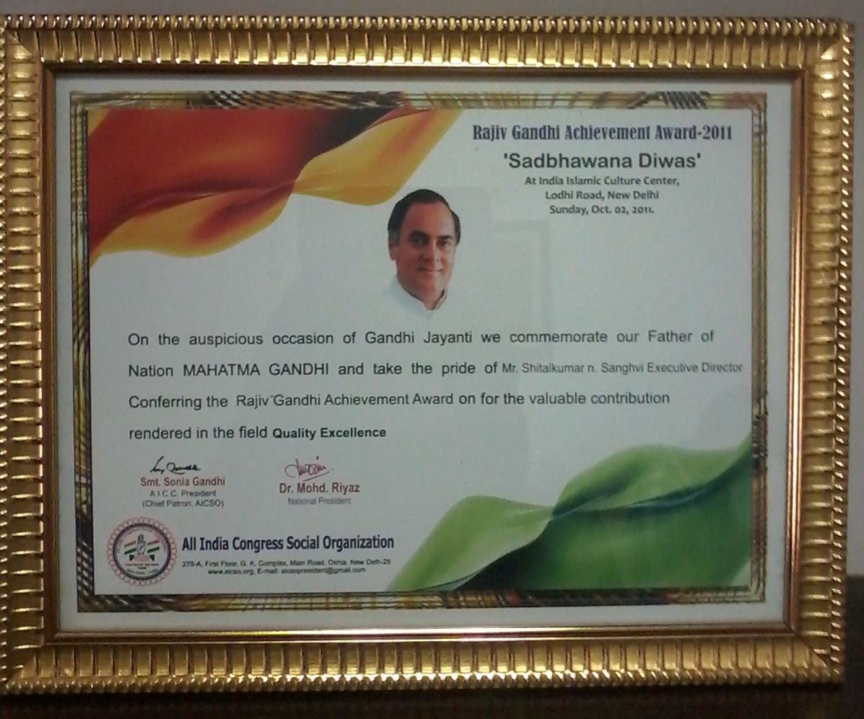
National Unity Award
13 June 2011
Rajiv Gandhi Achievement Award
2nd Oct 2011

Slide 42
Chairman and Managing Director
Joint Managing Director
Director Operations
Finance Manager
Marketing Manager
Taxation Manager
Accounts Manager
Production Manager
General Manager
Work Manager
Quality In charge
Human Resource
Maintenance In Charge
Store In charge
Electric In charge
Purchase Manager
Sales In Charge
Excise Manger
ERP Manager
Generator in charge
Loom in charge.
Tapeline in charge.
Finishing in charge
Loom Supervisor
Loom Operator
Plant Operator
Finishing Supervisor
Finishing contractor
Winder Boy
Dispatch in charge
Bobbin in charge
Rolls in charge

Slide 43
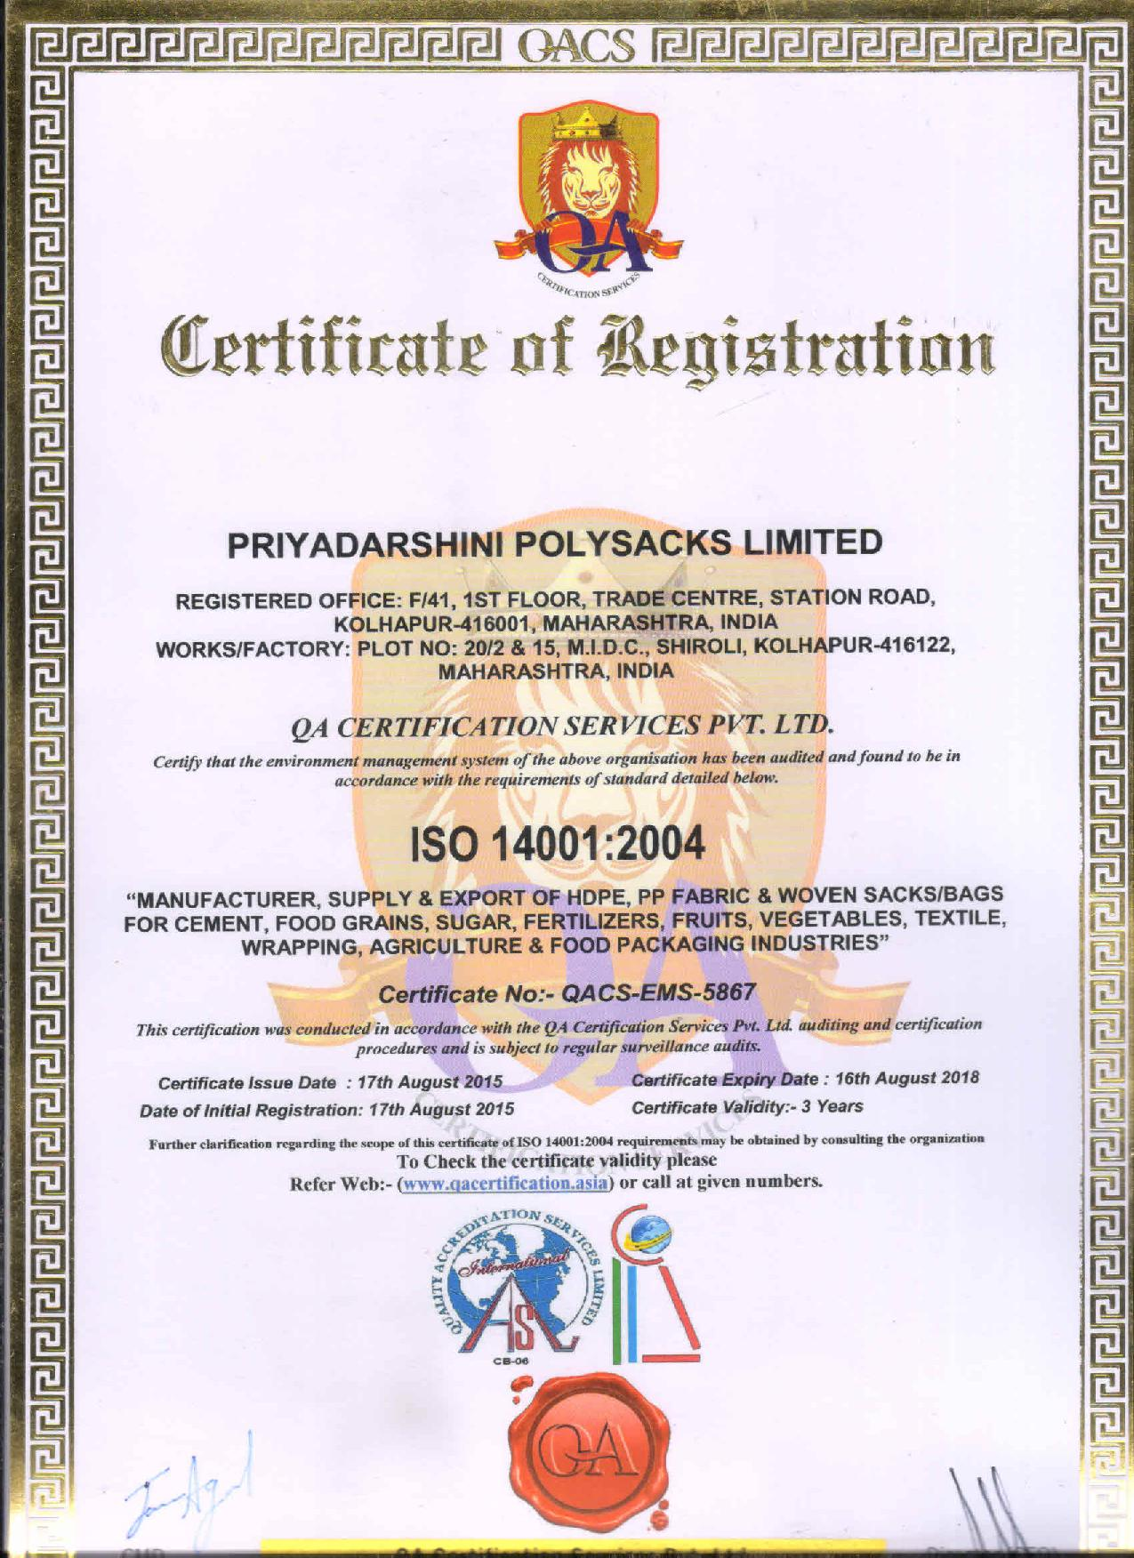
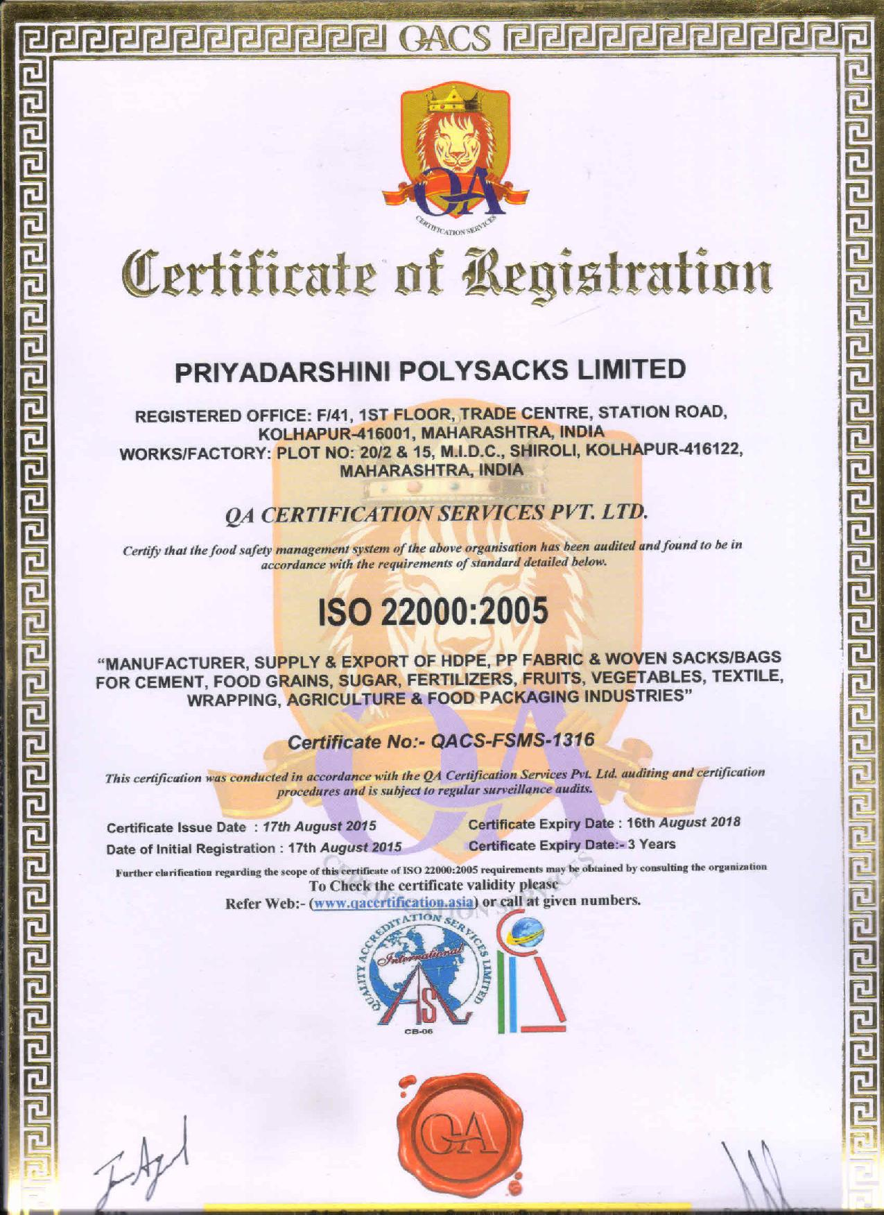
ISO Certifications

Slide 44
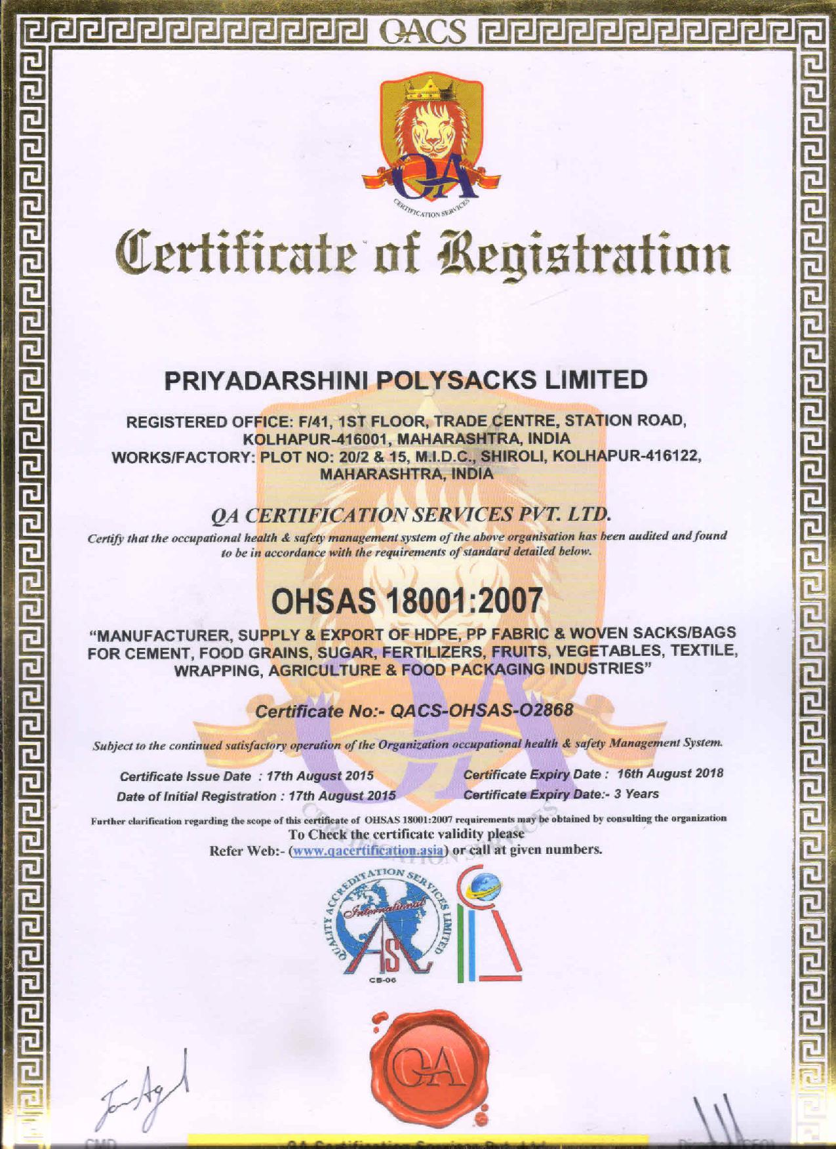

Slide 45
We conducted Safety and cleanness drive in month of July 2015

Slide 49
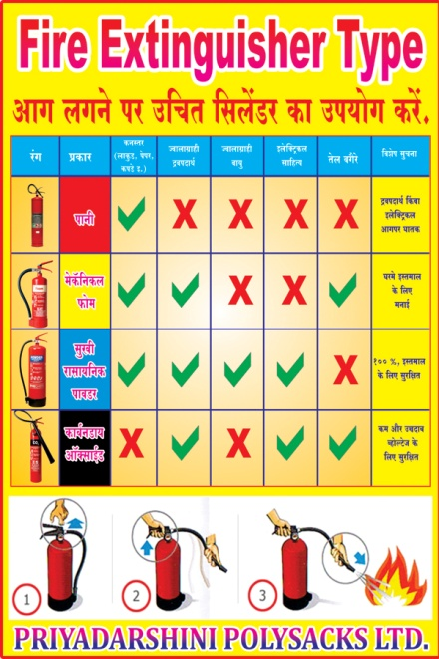

Slide 50
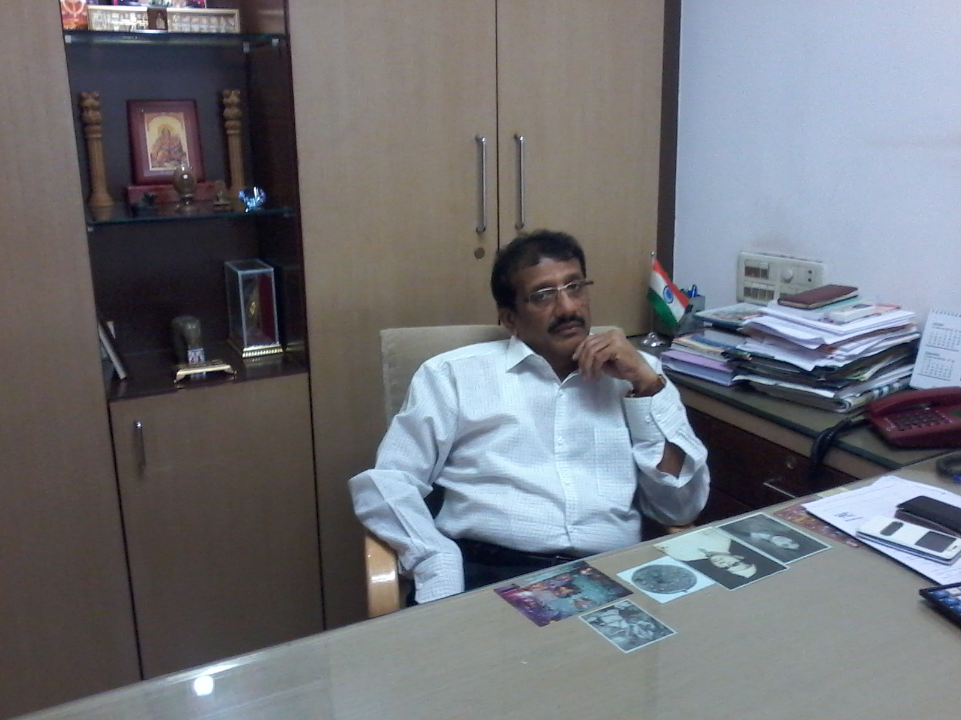
“Various Photographs”
Corporate Office
Chairman and Managing Director

Slide 51
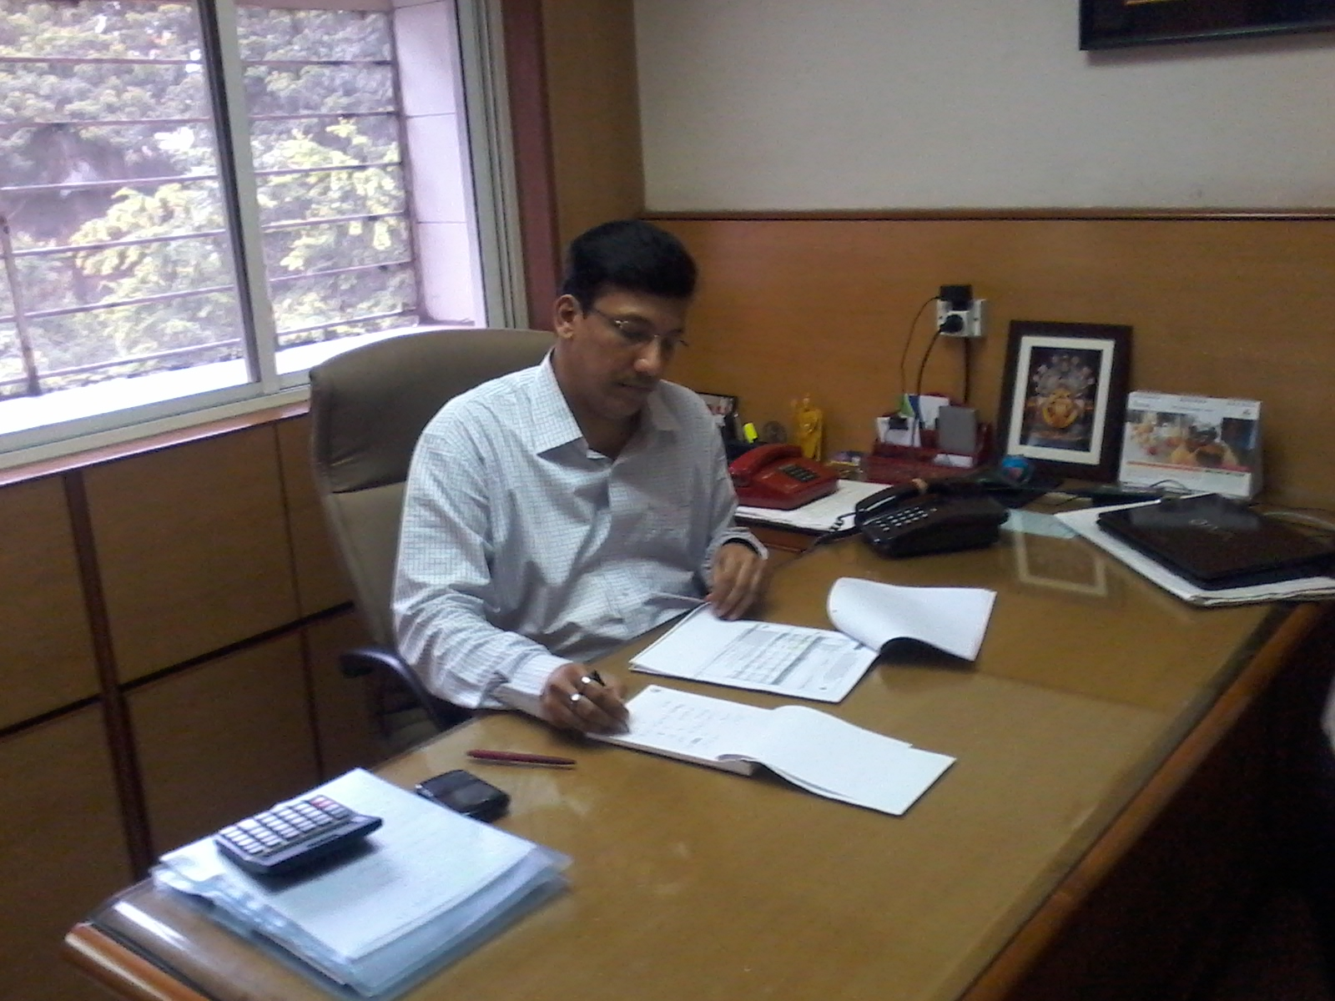
Joint Managing Director

Slide 52
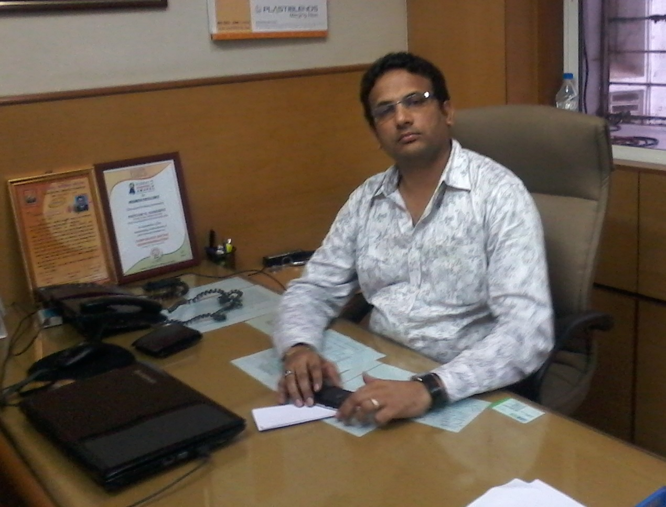
Director Operations

Slide 53
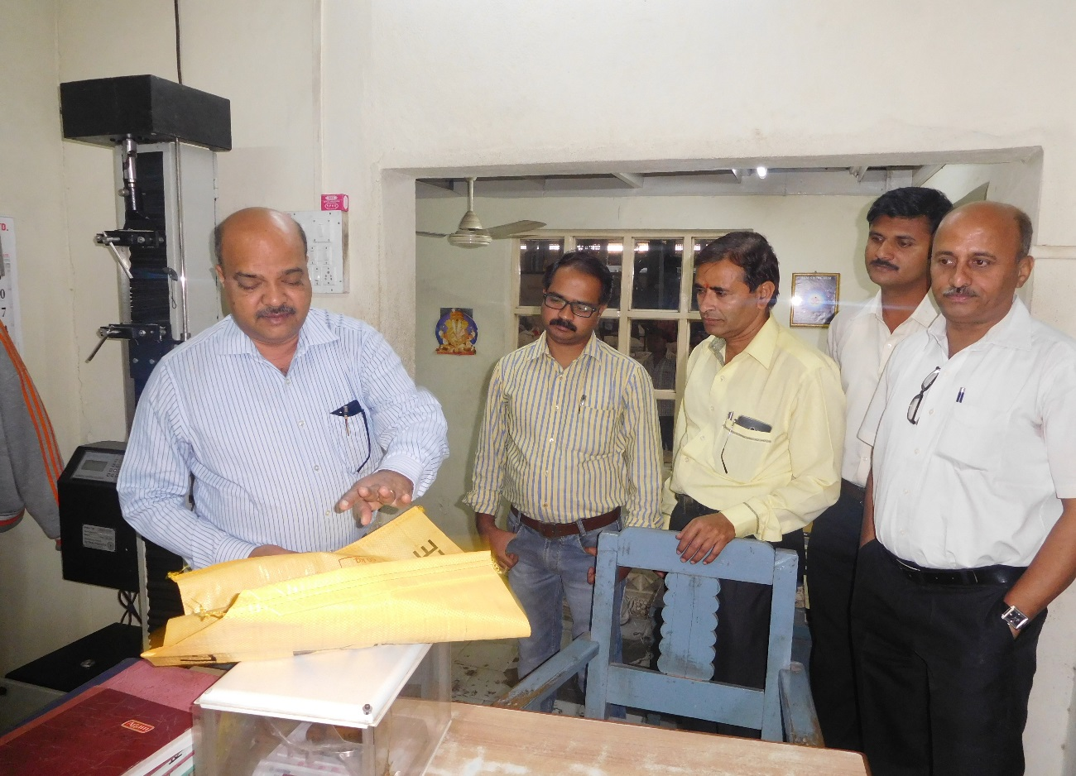
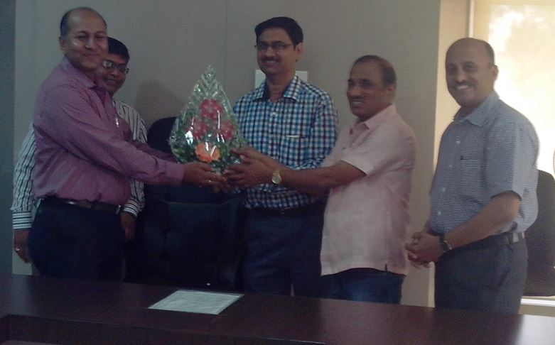
Guest visited at Priyadarshini
Ultratech Malkhed Cement
Ultratech Cement

Slide 54
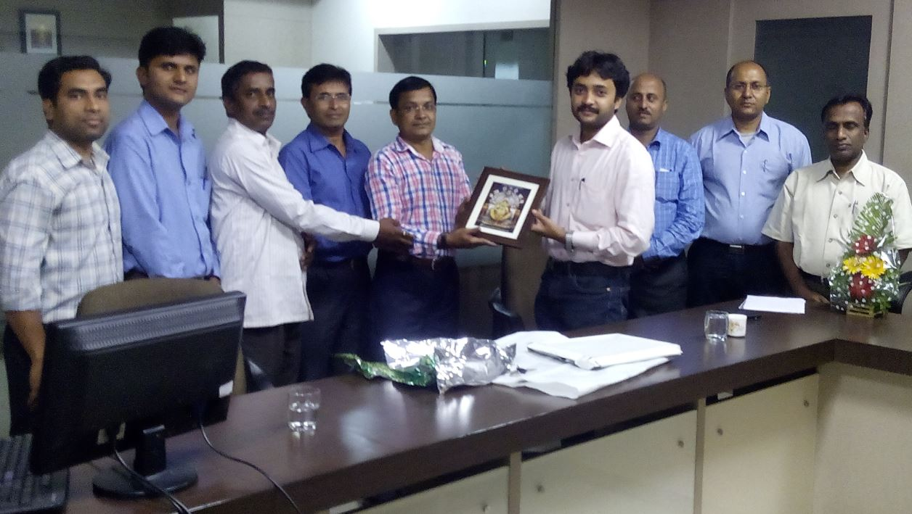
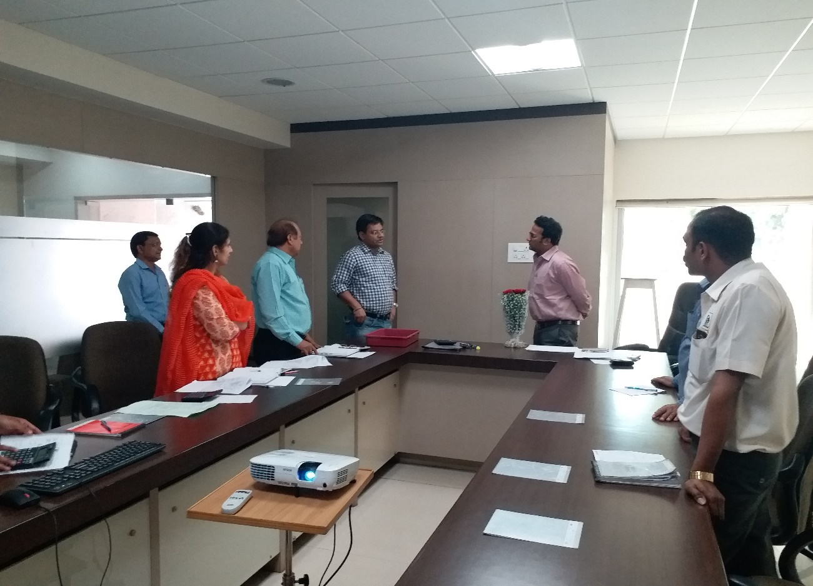
BIS (Bureau of Indian Standards) Pune -2015
BIS (Bureau of Indian Standards) - 2018

Slide 55
HDFC Bank Guest
RBL Bank Guest

Slide 56
Reliance Industries
EID Parry Sugar Inspection

Slide 57
EID Parry India Ltd
Ad Star Guest

Slide 58
Textile Student Visit- DKTE Ichalkaranji.

Slide 59
Bank Of Baroda
Parking

Slide 60
Main gate Unit-1
Main gate Unit-2

Slide 61
CCTV Camera Surveillance
Raw Material Unloading

Slide 62
Security Gate- Unit2
Front Elevation Unit-2

Slide 63
Shri Ganesh Riddhi Siddhi Temple
Office Building

Slide 64
Conference room
Directors Cabin

Slide 65
Guest House
Office Staff

Slide 66
Production Managers Cabin
HR Cabin

Slide 67
Labour Quarters
Quality Section

Slide 68
Store Staff
Store Section

Slide 69
Raw Material Godown
Liner Roll Winding

Slide 70
Extrusion Tapeline
Liner Plant

Slide 71
Inverter Winders
Roll Stock

Slide 72
Cement Weaving Looms
Sugar Weaving Looms

Slide 73
Leno Weaving Looms
BOPP / Fertiliser Lamination Plant

Slide 74
Spin Draw Windline (lofil) M/c’s

Slide 75
Advance Valvomatic Machine

Slide 76
Liner Cutting
PP Yarn Twisting Machine

Slide 77
Bag Gusset Machine
BCS Machine

Slide 78
Leno Finishing Section.
Auto Carona Printing Machine
Cement Finishing Section

Slide 79
Cement Bag Valve Testing
Bale Press M/c.

Slide 80
Bale Press M/c.
Stock of Finish Goods

Slide 81
Main Electric Panel Room
Transformer

Slide 82
Chiller Plant
Paharpur Cooling Tower

Slide 83
Dispatch
Wastage Godown

Slide 84
Liner Inserting session
Personal Financial Planning Session

Slide 85
Fire Extinguisher Training Session

Slide 86
Annual event

Slide 88
Annual Sports event

Slide 89
Other Photo’s
Raksha Bandhan
Raksha Bandhan

Slide 90
Tree Plantation By the company members
Unit -1

Slide 91
Tree Plantation By the company members
Unit -2

Slide 92
Company Uniform Distribution

Slide 93
Other Photo’s
Medical Camp 2016

Slide 94
Art Of Living Camp 2015 Conducted By Shri Shri Ravishankarji Team

Slide 96
Books Pujan on New financial year
Ganesh Puja

Slide 97
Ganesh Puja
Ganesh Puja

Slide 98
Ridhi Sidhi Ganesh Puja - Havan

Slide 100
Thank you!

